Slide 1
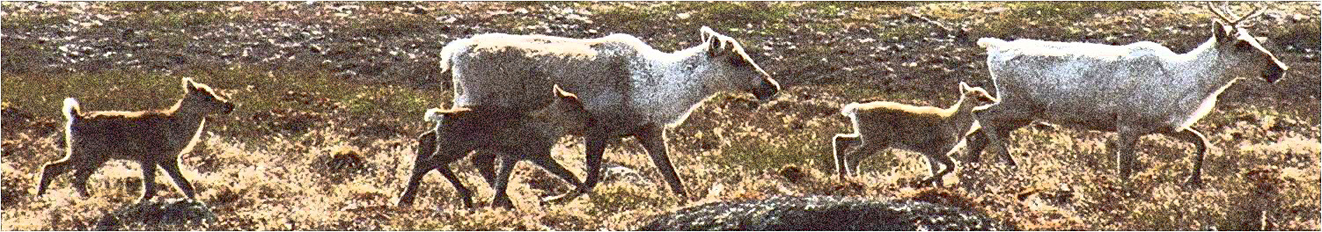
Current state of knowledge of calving grounds
Amount of information
Shifts in location
Habitat diversity
Notes:
A circum-arctic monitoring network is obviously the perfect place to exchange information and views on a circum-arctic assessment of calving grounds.
In late 2010, Monti Hummel of WWF Canada initiated this assessment to renew interest in how collectively we are going to look after calving grounds. This follows WWF’s 2012 Circum-Arctic Conservation Plan for Migratory Tundra Caribou and Wild Reindeer (WWF) emphasizes the importance of conserving calving and post-calving areas as being key to the broad conservation goal of maintaining the natural conditions under which caribou populations fluctuate – this is very similar to CARMA’s themes of managing through cycles of abundance.
Later this afternoon, we will be asking for your ideas about monitoring and conserving calving grounds through the cycles of abundance as well as best practices when information is incomplete.
When we consider the diversity of calving grounds we are also being faced with questions about how compatibility human activities are with conserving calving caribou and calving habitat
Monti will explain further about WWF’s involvement and I will update you on our progress and ask for your help in filling gaps.
The information that we have compiled is helping reveal patterns of use including shifts in location of the calving grounds - caution is needed because the amount of information is so variable between regions and calving grounds.
I’ll also mention a few points about habitat diversity.

Slide 2
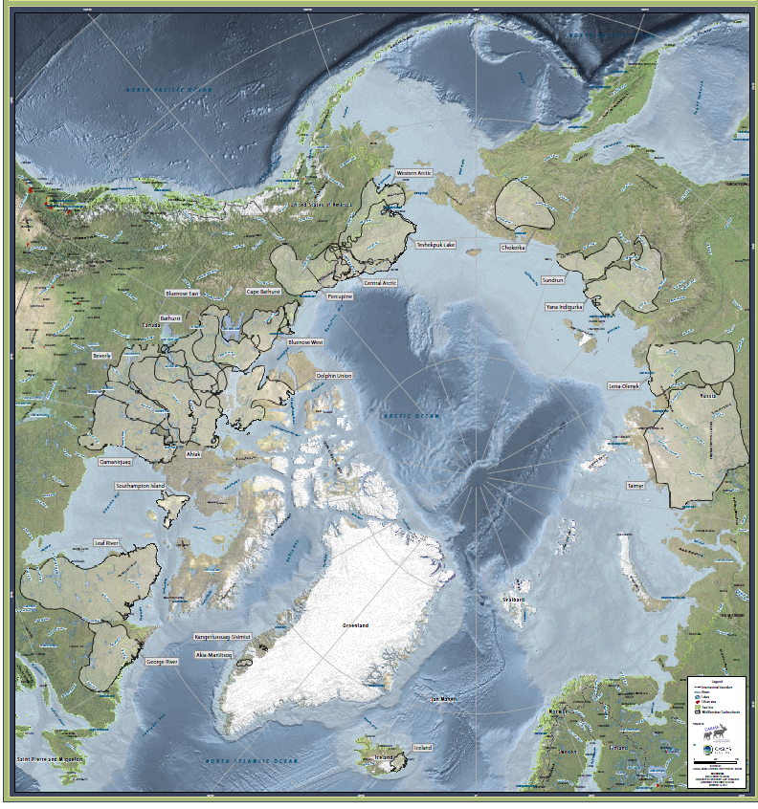
?
?
?
?
?
Notes:
This map shows the annual ranges - each of those herds has a calving ground but given the scale of the map, the calving grounds being the smallest annual range, would have been difficult to see.
– the question marks are where there is uncertainty about location and current information.
By searching the literature and talking to people, so far I have a list of about 54 calving grounds – there is uncertainty in that number as I may have missed or mis-intepretated information (and am hopeful for corrections) but also the number of calving grounds on how the calving grounds are defined – such as how many years of mapped locations are needed or what time period.
Definitions of calving grounds emphasis the geographic location – the place – even although location is likely more important as a pre-calving destination to bring the cows to a common place – it is may be the gregarious nature of the calving cows that confers evolutionary advantages rather than any particular habitat attributes.
Currently, the number of calving grounds for migratory tundra caribou is: four in Alaska; 12-20 in Canada; 10 in Greenland; and 17 calving grounds in Russia.
The amount of information varies markedly among the calving grounds -

Slide 3
Amount of Information
20% Analyzed
50%
unknown
30%
Mapped
Notes:
For almost half the calving grounds, I have a name and a location but almost no details so for the moment, I ranked these as unknown. And I will be trying to track down more about those as there may be an absence of information or I have not found the reports and maps
For almost a third of the calving grounds, we have mapped locations but the information is out of date; was not based on more than a few years and the boundaries were not well-described.
Lastly, for 11 of the about 50 calving grounds – about 22%; we have a description of location and caribou abundance based on an average of 16 surveys or satellite-collared caribou over average of a 32 year period.
The information is at an annual scale sufficient to describe inter-annual patterns of use
For those calving grounds, I labeled them analyzed as they have been to varying degrees subjected to geostatistical analyses at the annual scale or cumulative use has been mapped.
However, the those geostatistical analyses are few and tend to be between 5 and 10 years old.
Current (on-going) portrayal of annual use and patterns of use appears mostly unavailable although, ironically, it seems it does become available during environmental assessments.

Slide 4
Patterns of use
Directional shift
Non-directional shift
BAH, LRH, GRH
PCH
WAH, TLH, BEV, AHI QMH, TAI
CAH
Notes:
Currently, we can describe two inter-annual patterns of use based on the 11 herds with most information on consecutive calving grounds and which has been both analyzed and is available
We excluded the instances when pre-calving migration delayed – snow and melt conditions as atypical years
Sampling limitations and complications such as frequency of sampling = jumps in calving distribution and length of sampling period – teasing generalities is a challenge
Non-directional for 6 herds – for example WAH over 40 years and 5 herds have periods of both directional shifts and periods when consecutive calving grounds were clustered (non-directional shifts) -
Possible mechanisms are a) shifts track habitat such as annual rate of greening – decadal patterns in those attributes -PCH possible example
(b) gregarious indexed by forage density – longer term tied to changing abundance (c) industrial disturbance
The two patterns of directional shift and non-directional shift should be treated as preliminary and tidier than actually is realistic – more like research questions than firm conclusions – this is because caribou are adaptable in their use of their seasonal ranges and conditions are changing – for example trends toward increasing shrubs on the tundra. We can expect changes in how caribou use their calving grounds and we can expect changes as we learn more – in particular these patterns are based on only 11 of the about 54 herds with enough information (mapped calving grounds)

Slide 5
Bathurst herd, Canada
Calving distribution map from Gunn et al. 2008
Notes:
Bathurst both directional and non-directional shifts as two clusters (non-directional shifts) separated by an 11-year period of directional shift
Complication caused by frequency of monitoring
The mean overlap between peak calving grounds as determined from surveys from 1966 to 1986 was 54% ± 4.2%; and from collared caribou from 1996 to 2007 was 32% ± 4.0%;
The distances between centroids were highest between 1982 and 1996, based on only four aerial surveys over 15 years
The average yearly shift rate was 21 km (± 4.0 SE) for the 1996-2007 cluster of 11 centroids and about 13 km for the 1966-1980 cluster of 7 centroids.
The distance between the centre for 1966-1984 grouping and 1996-2007 grouping was 250 km.
Have to consider individual switches relative to shifts of geographical locations – likely mediated by caribou numbers and essential characteristics of calving (gregarious) and its relationship to foraging
Second example is George River herd

Slide 6
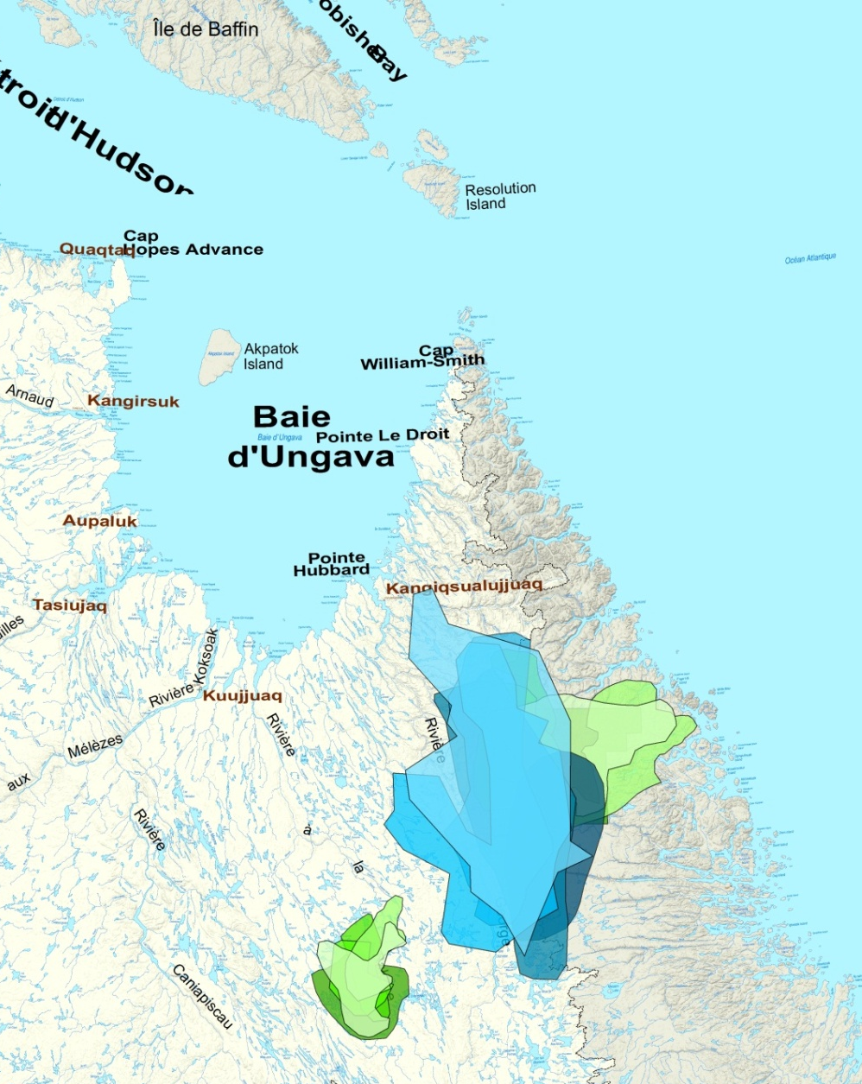

George River herd, Canada
2010
1982 to 1987
1974 to 1980
Notes:
6
Slide is courtesy of Joelle Taillon
George River under-going large changes in abundance
(1) 1974–1987 (increasing population and calving ground size), (2) 1991–2000 (population decline, large calving grounds); and (3) 2006–2010 (small population, small calving grounds).
Centroids of the RG calving ground were clustered from 1974 to 1982, then shifted West by 156 (14) km from 1984 to 1991.
From 1991 to the early 2000’s the RG calving ground centroids were clustered, then moved eastward towards the Labrador coast by 227 (14) km 2006 to 2010.
From 2006 to 2010, the centroids have remained clustered.
In Northern Québec, shifts in calving grounds could be related to changes in population size that can induce range degradation, or to habitat preference.
GRH is unusual as such a low proportion of tundra but LRH also shows long-term directional and non-directional shifts possibly repeated over a longer time

Slide 7
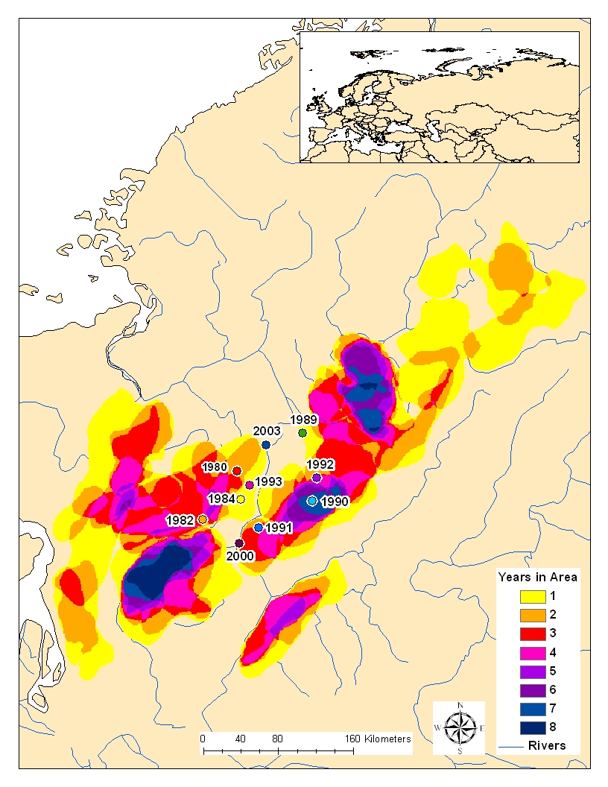
Taimyr wild reindeer. Russia
Meerdink, S. and Petrov, A. 2012. Taimyr wild reindeer spatial fidelity and calving grounds dynamics in a changing climate. ARCSES working paper 001-2012. University of Northern Iowa, IA
Notes:
Taimyr herd – map shows 8 years of overlapping with the centroids – suggests non-directional shifts at least between 1982 and 2003

Slide 8
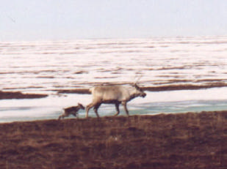
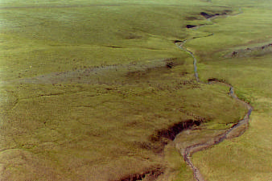
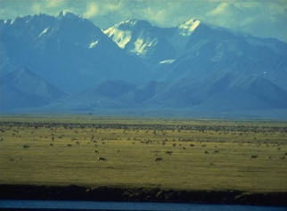
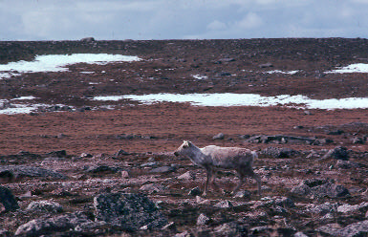
Habitat diversity
Notes:
Generalities are that calving grounds tend to be at the northern end of annual ranges and offer greening vegetation to coincide with peak nutritional needs, but there are considerable differences in vegetation and terrain.
Habitat of calving grounds diverse – photos show coastal plains , rolling hills and more rugged uplands – Size and shape vary – molded by geography and underlying geology – Canadian Shield – and soils
Strong circum-arctic gradients in climate

Slide 9
Cumulative growing degree days
Notes:
Based on MERRA
Cumulative growing degree days for 1 and 10 June It is simply the accumulation of growing degree days over the entire growing season - a growing degree day is the number of degrees that the average temperature is above 0 degrees C.
More comparison underway using CARMA’s MERRA data

Slide 10
Bedrock lichen
Sparse vegetation
Wet sedge
Tall shrub
Tussock, sedges, shrubs
Calving grounds
Larger area – similar climate
Notes:
Graphs thanks to WWF’s James Snider – GIS miracle-worker
The different colored bars are the different vegetation classes based on satellite imagery
On the left is composite calving grounds compared to the other tundra areas within the same climate zone
the comparisons suggests selection at larger scale for wet sedge, tall shrub and bedrock lichen
this suggests selection for foraging conditions which is similar to similar to Russian study and Alaskan studies using selection for NDVI satellite measures of greening at the annual scale.
Means need to understand more about selection and suitability of surrounding habitat – likely relates to likelihood and extent of shifts

Slide 11
Bluenose West
Bluenose East
Notes:
Neighbouring calving grounds differ in vegetation
Bluenose East more wet sedge while Bluenose West more sparsely vegetated bedrock –

Slide 12
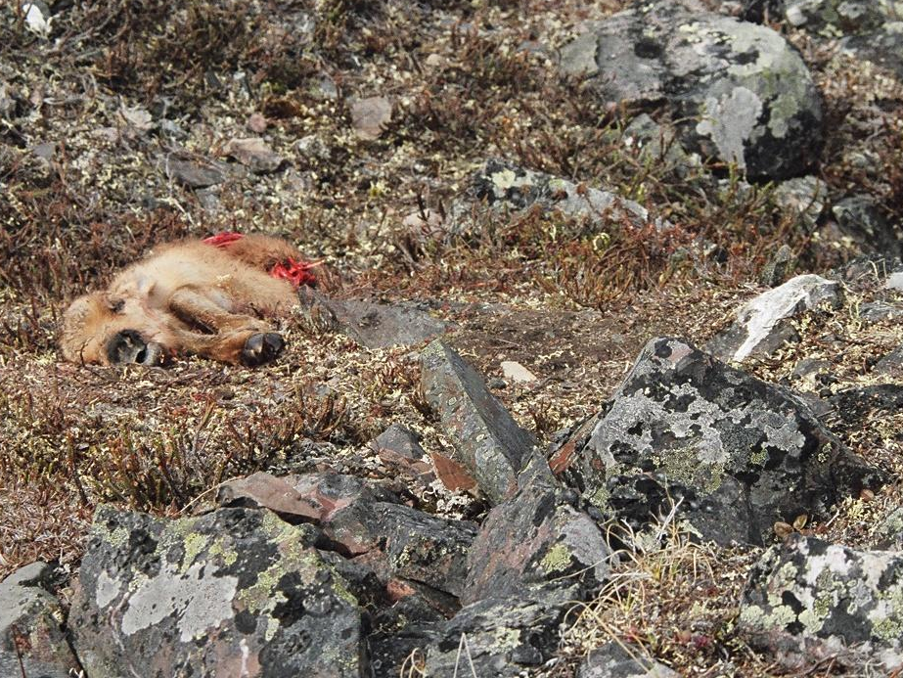
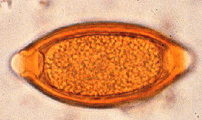
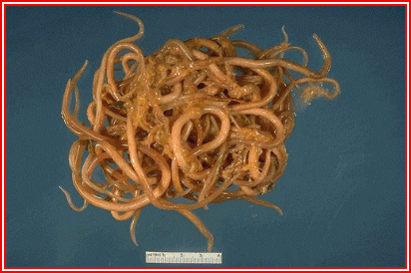
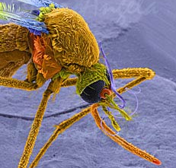
Notes:
It is not that we are ignoring predation or parasites – it is more a reflection of the availability of information except for a very few herds
The assessment of calving grounds currently has information for a few herds on at least differences in relative numbers and species of predators
less information is available on parasites – photo inset shows a stomach worm egg and adult worms – likely place as much a role in calving strategies as predation but more information needed.
Likely than parasites including biting insects such as mosquitoes play a part in foraging ecology and the timing of departure from calving grounds and that this varies considerably

Slide 13
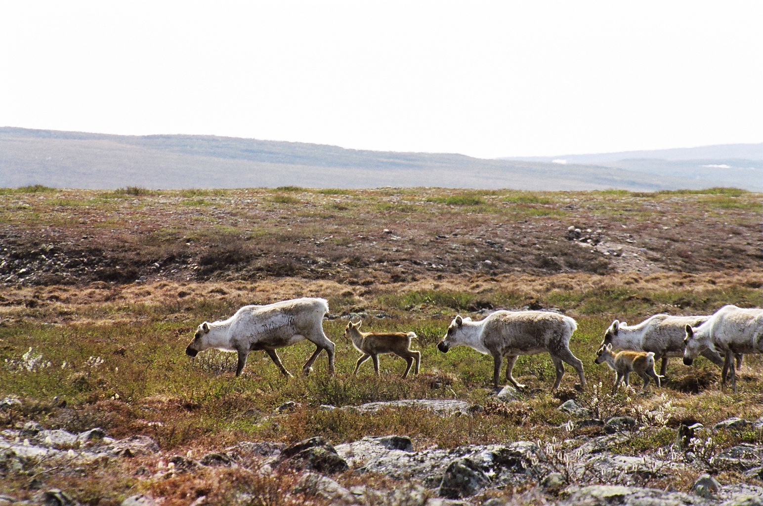
Notes:
In summary – current state of knowledge about patterns of use and habitat diversity are :
1) so far most information for relatively few herds which tend to be the larger herds – risky as does not capture full range of calving (especially more dispersed calving)
2) For half the calving grounds, we have almost no information and this will need collaboration to fill those gaps and complete the inventory of calving grounds
3) Only 11 herds have geostatistical analyses of consecutive calving distributions and even those analyses are mostly 5-10 years old.
4) So far, more herds show annual overlap of calving grounds is non-directional and the calving grounds do not appear to shift.
5) For a lower proportion of herds, there are periods when annual calving grounds are clustered (non-directional overlap) interspersed with years when the overlap is directional and the calving ground shifts. For the three herds, this pattern appears to be related to changes in abundance – shifts during peak and declines; for another herd (PCH) the annual shifts are both clustered and directional and appear to coincide with snow melt and plant green up.
6) Obviously we need to understand how to predict – role of geography (PCH) and geology (are Canadian Shield herds more likely to shift as different shape of abundance cycles)
The diversity of habitats (plant communities, climate, geology) vary considerably among calving grounds; probably caribou select for foraging conditions from what is available in the general area rather than a fixed set of attributes – however evidence so far from vegetation patterns and annual rates of green up do suggest that caribou are selecting for foraging conditions such as timing of peak nutrition relative to demands of lactation.
In relation to conservation, measures will have to be adaptable and variable to accommodate the calving strategies of different herds at different times in their abundance cycles.
How should calving grounds be monitored and conserved through the cycle of abundance? Nishi
2. How should “best practises” be for calving ground conservation reflect the state of information? Petrov
3. How can human activities be compatible with conserving calving caribou and their calving ground habitat? Ray

Slide 14
